Slide 1
Fundamental of it: ONLINE INTERACTION CLASS
BE-Software I (Day)
2ND July, 2020

Slide 2
Transmission Channel
A path between two nodes in a network.
It may refer to the physical cable, the signal transmitted within the cable or to a sub-channel within a carrier frequency.
Examples: Co-axial cable, microwave, Ethernet, radio wave

Slide 3
Wired vs Wireless Network
Comparison Basis | Wired Network | Wireless Network
 | The wired networks require that the cables are connected to each and every one of the nodes in the network. | Wireless devices require WLAN cards and access points for communication.
Cost | The cost of a wired network is lower compared to the wireless network since Ethernet, cables, and switches are not expensive. | Wireless networks require equipment such as wireless adapters and access points that are quite expensive. The cost of wireless networks is high compared to wired networks.
Speed | The wired network can offer a bandwidth of 100 Mbps with Fast Ethernet technology. | The maximum bandwidth provided by the wireless network is approximately 11Mpbs.

Slide 4
Wired vs Wireless Network
 | Wired Network | Wireless Network
Reliability | Ethernet cables, the switches that are used in wired networks are reliable. | The reliability of the wireless network is lower compared to the wired network.
Security | The security considerations for a wired network connected to the internet are firewalls. Firewall software can be installed on each computer. | WLANS uses equivalent encryption of privacy by cable (WEP) to protect the data. This makes wireless networks as secure as wired networks.
Mobility | Mobility is low as devices are fixed | It allows high mobility as devices can move freely

Slide 5
Cable vs Broadcast
Cable distribution medium is a physical cable running from a cable company’s “head-end”)to the consumer’s (audience) home or place of business.
Cable was originally intended to provide television programming content, but many cable providers now offer other services as well via their cable including internet connectivity and voice-over-IP telephony phone service.
Broadcast medium is a radio frequency wireless transmission from one earthbound terrestrial location to another terrestrial location
Satellite broadcast medium is a radio frequency wireless transmission from an orbiting satellite directly to the consumer’s home or business.

Slide 6
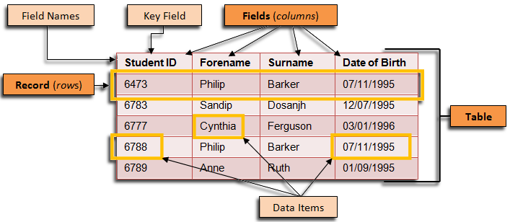
DATABASE
A database is a collection of information that is organized so that it can be easily accessed, managed and updated.

Slide 7
Features of Database
Minimum Duplication and Redundancy.
Saves Storage Space and Cost.
Anyone Can Work on It.
Large Database Maintenance.
Provides High Level of Security.
Permanent Storage of Data.

Slide 8
Properties of Database
Atomicity
Atomicity in database ensures that the transactions are indivisible and irreducible where transactions either commit or abort. If a part of transaction fails then entire transaction fails.
Consistency
Any change in the values of a database at particular instance are consistent with changes to other values.
Isolation
Transaction in database ensures that the working transaction will not be changed or affected by any other transaction. In other words, modifications or updates made on one transaction is not viewed or changed by any other transaction.

Slide 9
Properties of database
Durability
Durability of the databases states that “once transaction has been committed, should remain in the same status” even in the case of failures such as power loss, database crash etc.

Slide 10
Multidimensional DATABASE
A multidimensional database is created from multiple relational databases. While relational databases allow users to access data in the form of queries, the multidimensional databases allow users to ask analytical questions related to business or market trends.
Multidimensional databases are used mostly for OLAP (online analytical processing) and data warehousing.
The data in multidimensional databases is stored in a data cube format.
It supports very fast access to summarized data.

Slide 11
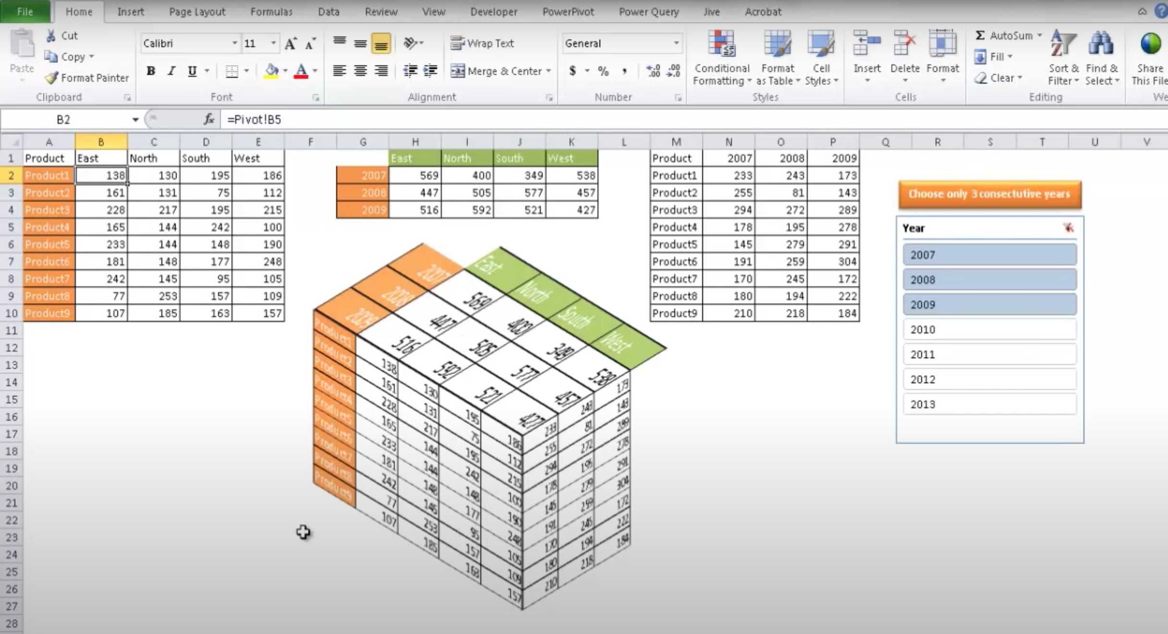

Slide 12
Advantages of Multidimensional Databases
Increased performance
Easy maintenance
Better data presentation

Slide 13
Disadvantage OF MULTIDIMENSIONAL DATABASE
One of the disadvantage of multidimensional databases are that it is quite complex and it takes professionals to truly understand and analyze the data in the database.

Slide 14
WEAK AI VS STRONG AI
Weak AI refers to any AI tool that focuses on doing one task really well.
The idea behind weak AI isn’t to mimic or replicate human intelligence but it’s to simulate human behavior
Strong Artificial Intelligence (AI) is a theoretical form of machine intelligence that is equal to human intelligence
Strong AI-powered machines have a mind of their own
Strong AI has a complex algorithm that helps it act in different situations, while all the actions in weak AIs are pre-programmed by a human.

Slide 15
Expert system
In artificial intelligence, an expert system is a computer system that emulates the decision-making ability of a human expert.
It is an interactive and reliable computer-based decision-making system which uses both facts and heuristics to solve complex decision
It performs by extracting knowledge from its knowledge base using the reasoning and inference rules according to the user queries.-making problems

Slide 16
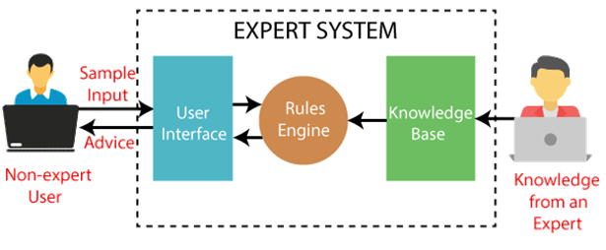
Expert system

Slide 17
Components of expert system
User Interface
it is an interface that helps a non-expert user to communicate with the expert system to find a solution.
It enables the user to give queries as an input in readable format and pass it to inference engine and display the output
Inference Engine (Rules Engine)
It is the main processing unit of ES
It fetches the relevant knowledge from the knowledge base, interpret it and to find a solution relevant to the user’s problem.
The inference engine acquires the rules from its knowledge base and applies them to the known facts to infer new facts.

Slide 18
Knowledge Base
The knowledge base represents facts and rules.
It consists of knowledge in a particular domain as well as rules to solve a problem, procedures and intrinsic data relevant to the domain.
The knowledgebase is a type of storage that stores knowledge acquired from the different experts of the particular domain.

Slide 19
Characteristics of ES
Human experts are perishable but an expert system is permanent.
It helps to distribute the expertise of a human.
One expert system may contain knowledge from more than one human experts thus making the solutions more efficient.
It decreases the cost of consulting an expert for various domains such as medical diagnosis.
They use a knowledge base and inference engine.
Expert systems can solve complex problems by deducing new facts through existing facts of knowledge, represented mostly as if-then rules rather than through conventional procedural code.
Expert systems were among the first truly successful forms of artificial intelligence (AI) software.

Slide 20
Advantages of es
These systems are highly reproducible.
They can be used for risky places where the human presence is not safe.
Error possibilities are less if the KB contains correct knowledge.
The performance of these systems remains steady as it is not affected by emotions, tension, or fatigue.
They provide a very high speed to respond to a particular query.
Not affected by emotions

Slide 21
CAPABILITIES OF ES
Advising
Provide decision making capabilities
Demonstrate a device
Problem solving
Explaining a problem
Interpreting input
Predicting result
Diagnosis

Slide 22
Limitations of es
The response of the expert system may get wrong if the knowledge base contains the wrong information.
Like a human being, it cannot produce a creative output for different scenarios.
Its maintenance and development costs are very high.
Knowledge acquisition for designing is much difficult.
For each domain, we require a specific ES, which is one of the big limitations.
It cannot learn from itself and hence requires manual updates.

Slide 23
Example of es
CaDeT
The CaDet expert system is a diagnostic support system that can detect cancer at early stages
PXDES
It is an expert system that is used to determine the type and level of lung cancer
MYCIN
It was also used for the recommendation of antibiotics and the diagnosis of blood clotting diseases.
DENDRAL
It was an artificial intelligence project that was made as a chemical analysis expert system. It was used in organic chemistry to detect unknown organic molecules with the help of their mass spectra and knowledge base of chemistry.

Slide 24
E-Payment
E-payment system is a way of making transactions or paying for goods and services through an electronic medium without the use of check or cash.
Electronic payment methods allow processing in a faster, cheaper, and more convenient manner than paper-based cheques.
Credit card, debit card, Automated Clearing House (ACH),E-wallet, Net Banking, smart card

Slide 25
Advantages of e-payment
Instant payment
Quick and easy setup to facilitate more sales
Reliable mode of payments for Global merchant
Induces more trust in consumer
Add convenience to recurring payment
Credit cards to facilitate low balance purchases
Influence impulse buyers

Slide 26
Disadvantages of e-payment
Security concerns
It is vulnerable to hacking and phishing attacks
These security concerns may make some people reluctant to use e-payment systems.
Disputed transaction
If someone uses your company's electronic money without your authorization, without sufficient information about the person who performed the transaction, it can be difficult to win the claim and receive a refund.
Increased business cost
Enterprises with in-house e-payment systems must incur additional costs in procuring, installing and maintaining sophisticated payment-security technologies.

Slide 27
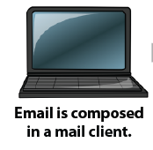

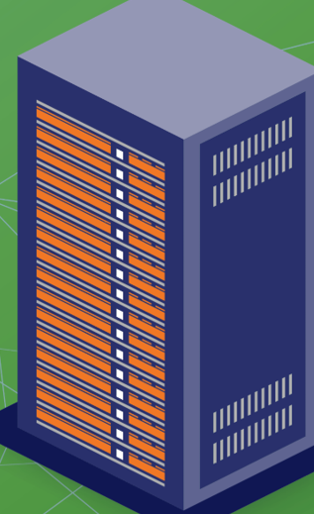
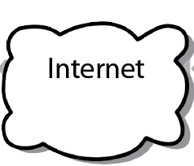

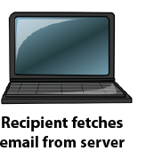
HOW EMAIL WORKS ?
SMTP
DNS
Domain
User acc
IMAP
MTA
IPOP

Slide 28
How email works?
The email gets sent by the client to an outgoing mail server via Simple Mail Transfer Protocol.
SMTP contacts DNS to translate domain name to IP address
Then, it finds out if that domain has any “MX” or mail exchange servers on it and makes a note of it.
Now that the SMTP server has the proper info, the message gets sent from that server to the target domain’s mail exchange server
This server is referred to as an MTA, or Mail Transfer Agent
MTA decides where to put the mail
Receiver fetches the mail using client via IMAP, IPOP

Slide 29
HTML/CSS/xml
Hypertext Markup Language (HTML) is the standard markup language for documents designed to be displayed in a web browser.
HTML is used to create electronic documents (called pages) that are displayed on the World Wide Web. Each page contains a series of connections to other pages called hyperlinks.
It can be assisted by technologies such as Cascading Style Sheets (CSS) and scripting languages such as JavaScript.
HTML consists of tags such as <body> </body>, <h1> etc
HTML tags are the hidden keywords within a web page that define how your web browser must format and display the content. Most tags must have two parts, an opening and a closing part

Slide 30
CSS
Cascading Style Sheets is a style sheet language used for describing the presentation of a document written in a markup language like HTML
Cascading Style Sheets (CSS) is a simple mechanism for adding style (e.g., fonts, colors, spacing) to Web documents.
CSS can be added to HTML in 3 ways:
Inline - by using the style attribute in HTML elements.
Internal - by using a <style> element in the <head> section.
External - by using an external CSS file.

Slide 31
xml
XML stands for Extensible Markup Language.
It is a text-based markup language derived from Standard Generalized Markup Language (SGML).
XML was designed to be self-descriptive
XML was designed to store and transport data
XML is just information wrapped in tags.
XML Does Not Use Predefined Tags

Slide 32
xml
<note> <to>Student</to> <from>NCIT</from> <heading>Reminder</heading> <body>Don't forget to live!</body> </note>
Note
To: Student
From: College
Reminder
Don’t forget to live!

